Slide 1

Improving emotional response
using RL with Multi-Step prompting
National Yang-Ming Chiao-Tung University
Institute of Electrical and Computer Engineering
Po-Chuan Chen

Slide 2




Outline
Problem Statement
Method
Background

Slide 3


Problem Statement
I feel bad today. Because, …
OK. Let me heard about your feeling.

Slide 4
But actually …

Slide 5
Problem Statement
1200 : 1

Slide 6

Problem Statement

Slide 7
Problem Statement
It provides a modernized counseling platform.
It enables university counselors to efficiently meet the diverse needs of students’ problems.
It needs to response based on user’s emotion.

Slide 8



What is Natural Language Processing?
Automatic Speech Recognition
Text Generation
Sentiment Analysis
Question Answering

Slide 9
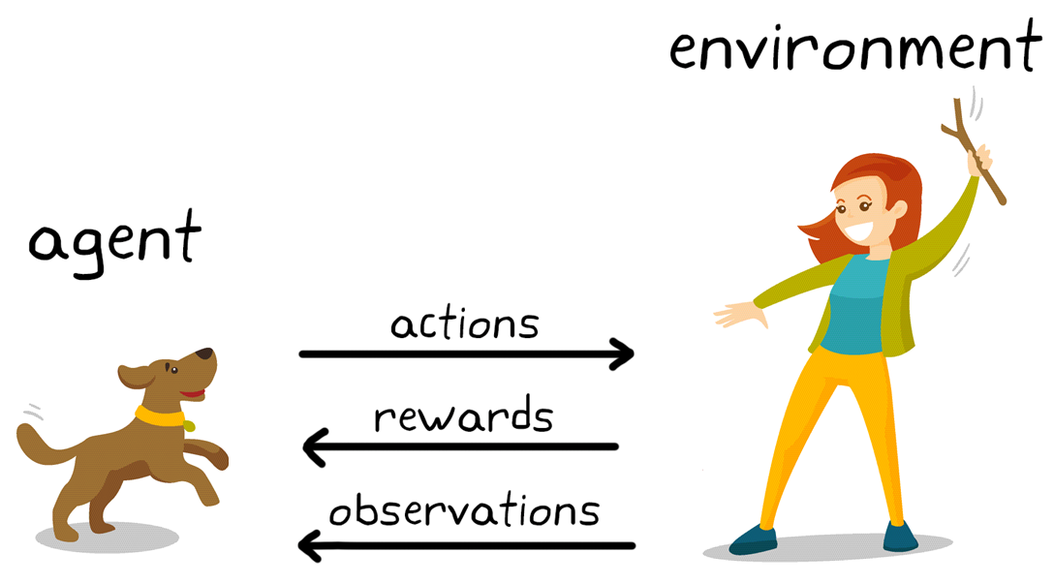
What is Reinforcement Learning?

Slide 10





Select prompt based on input context
Architecture
Happy
Happy
[Prompt, Input Context]
No
$$π_{L}$$
Sad
Sad
Angry
Angry
Yes
Do we need new prompt?
$$π_{H}$$
Shame
Shame

Slide 11


Select prompt based on input context
Architecture
Happy
Happy
[Prompt, Input Context]
No
$$π_{L}$$
Sad
Sad
Angry
Angry
Yes
Do we need new prompt?
$$π_{H}$$
Shame
Shame

Slide 12
Thank you for listening

